Slide 1
Implementation Guide:
Shopify / Mirakl Connect

Slide 2
Marketplace Overview
The ShopSimon™ marketplace brings the Simon experience online. We deliver an elevated, brand-safe environment for premium and luxury brands like yours to sell full-price, on-sale, clearance, and/or outlet inventory direct to a targeted customer. Retailers will integrate onto the platform to provide automated catalog feeds, accept orders, and to communicate order related information. Retailers are responsible for managing their own products, pricing, inventory, and promotions on ShopSimon™. FULFILLMENT & SHIPPING Retailers are responsible for all aspects of each customer order. This includes acceptance, fulfillment, packaging, labeling, shipping, return acceptance/processing, cancellations and fulfillment-related chargebacks. Retailers will need to offer free standard ground shipping for customers in the continental United States. CUSTOMER SERVICE ShopSimon™ is responsible for general customer service inquiries, including initiating returns. ShopSimon™ will provide first contact customer support. ShopSimon™ Customer Service will escalate issues to retailers directly using the ‘Messages” tool in the ShopSimon™ portal. It is expected that retailers will handle these customer direct inquiries to the same standards it does its own customer service. REFUNDS & RETURNS ShopSimon™ will provide the customer with a pre-paid return label and a return packing slip. Retailers will process refunds and adjustments for orders that are cancelled and returned in ShopSimon™ Retailer Portal. FINANCIAL RECONCILIATION ShopSimon™ will collect all amounts due from customer for products ordered on platform. ShopSimon™ will issue payment to retailers based on net sales less commissions, return shipping and service-related chargebacks. Payment will be directed to bank account listed in the ShopSimon™ portal. ShopSimon™ will collect and remit to applicable tax agency any sales taxes on the sale of retailer’s products. Retailers may provide ShopSimon™ their internal order number. This will be featured on return labels and financial reports.

Slide 3
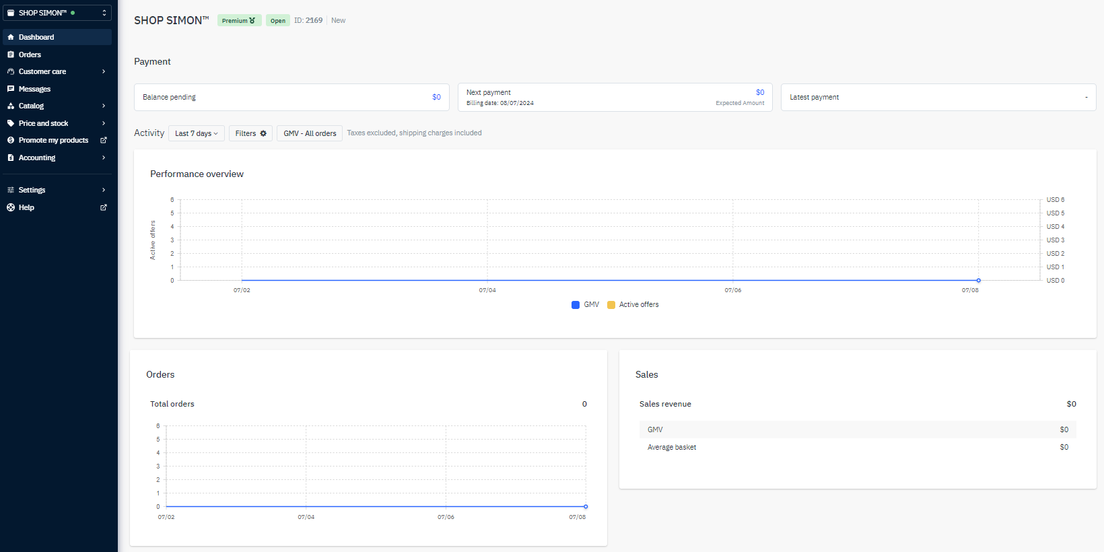
ShopSimon™ Portal
As a seller, you will have your own designated ShopSimon™ portal account that will serve as a home base for business reporting, reviewing your product data and inventory position, managing customer service escalations, and financial reconciliation. The portal’s main dashboard is where you can access business reporting tools.
Main Dashboard

Slide 4
ShopSimon™ Portal
To complete account setup in the ShopSimon™ portal, there is required business information we need from each brand partner. Key Sections to complete in ShopSimon™ portal: Returns Information - the address input in this section will be listed on return labels and ultimately where returns will be shipped. Your Team - Key contact information by department Customer Service - Used for customer service escalations Contact Details (separate tab) - Business details, including Tax ID # and Business Registration Number Payment Details (separate tab) - Enter bank account where ShopSimon™ payment will be sent We will also need a copy of your W9 and a bank verification letter to complete setup with our finance team.

Slide 5
Onboarding Overview
ADMINISTRATIVE Execute contract. Complete account profile in portal. W9 and bank verification letter submitted. DISCOVERY Review onboarding requirements/timeline. Determine ShopSimon™ launch assortment and tag with “SIMON” in your Shopify store. MIRAKL CONNECT Create an account with Mirakl Connect, this is where you will gain access to Shopify Connector. Sync your Shopify store with Mirakl Connect. Complete configuration setup in Mirakl Connect. Create ShopSimon™ listing in Mirakl Connect Export launch assortment & map file into ShopSimon™ portal using Mapping Wizard. Review initial import data and resolve any errors in the portal. Conduct final review & make sure your offer and order synchronization are activated. STOREFRONT Submit required creative assets ShopSimon™ team completes brand storefront build. LIVE OPERATIONS The following tasks are executed automatically based on the default Shopify Connector cron job schedule. Price, stock, and orders synchronize: every 15 minutes Following the steps on page 9-11, brands will need to use Mirakl Connect each time they wish to add new products to the portal. The connector allows you to review and manage the orders you are receiving on the ShopSimon™ marketplace in your Shopify store. Cancels must be manually processed in Shopify and the ShopSimon™ portal. Refunds must be manually processed in the ShopSimon™ portal. Review common connector FAQ and troubleshooting topics. For additional support you can consult with the ShopSimon™ team.

Slide 6
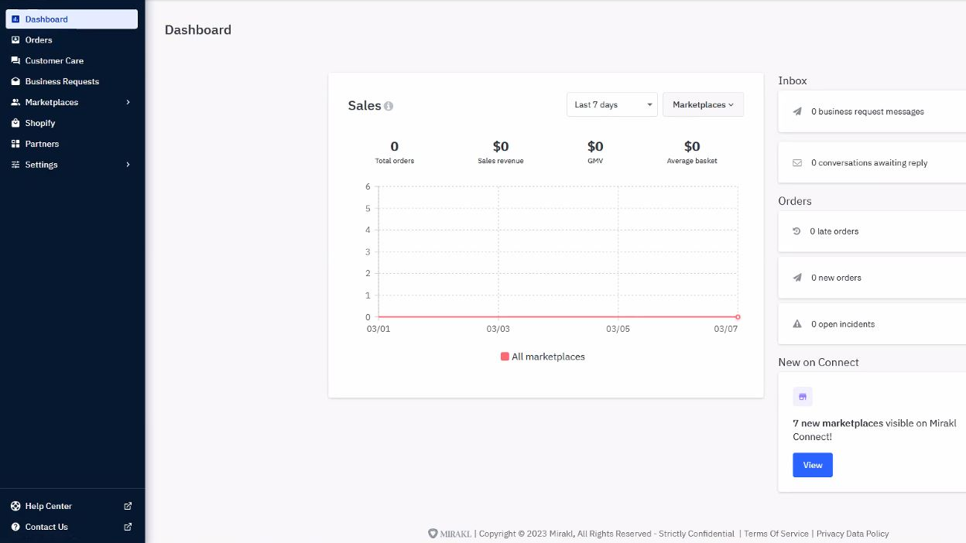
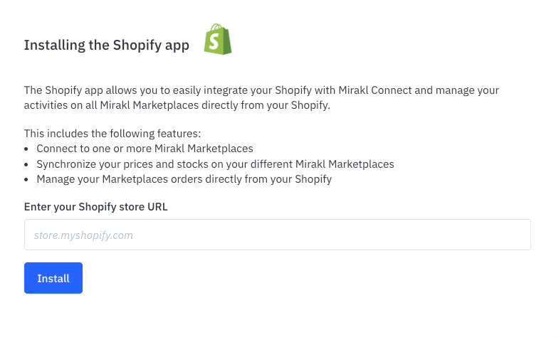
Mirakl Connect
Connecting Your Shopify Store to Mirakl Connect To install, login to your Mirakl Connect account and click the “Shopify” link on the left toolbar. This will start the installation process and you will be prompted to enter your Shopify Shop URL (i.e. storename.myshopify.com).
Access the Shopify Connector
Enter Shopify URL
Click Install to establish sync
Click here for additional information

Slide 7
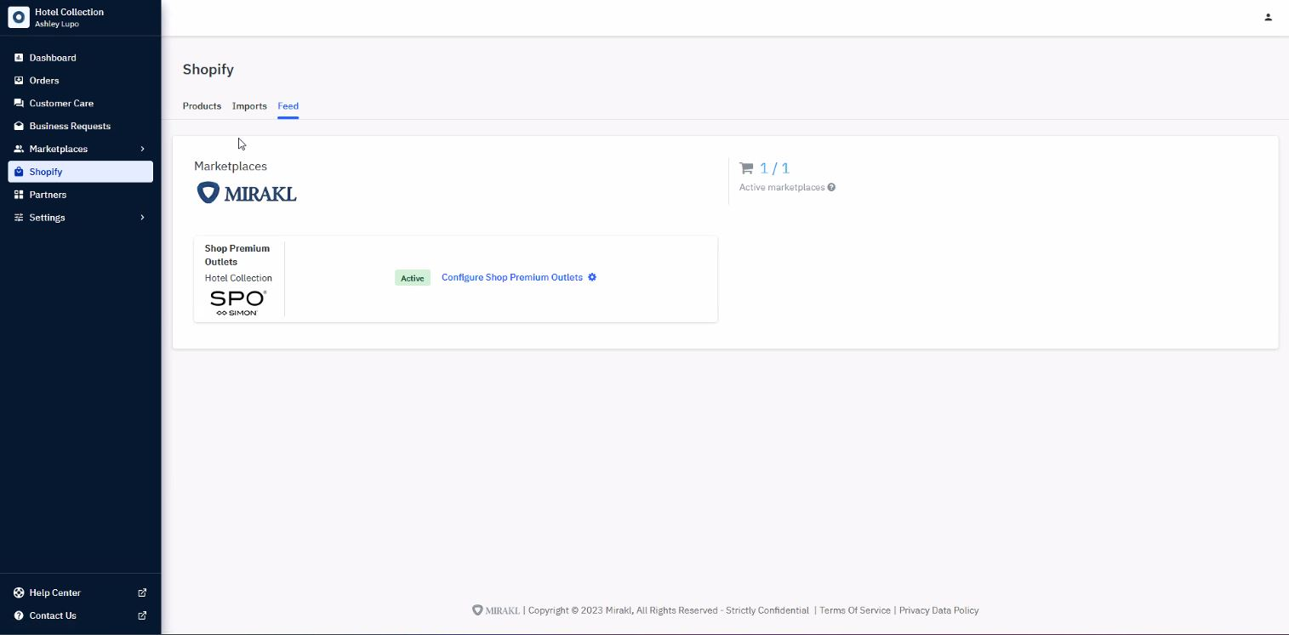
Mirakl Connect
ShopSimon™ Configuration Click on Shopify > Feed to find the ShopSimon™ marketplace. Click ‘Configure ShopSimon™’ to start the configuration process. If you do not see ShopSimon™ listed, please go to Marketplaces > My Stores and hit the “Import Stores” button at the top right of the page to import the marketplace.
Click here to start configuration work
Click here for additional information

Slide 8
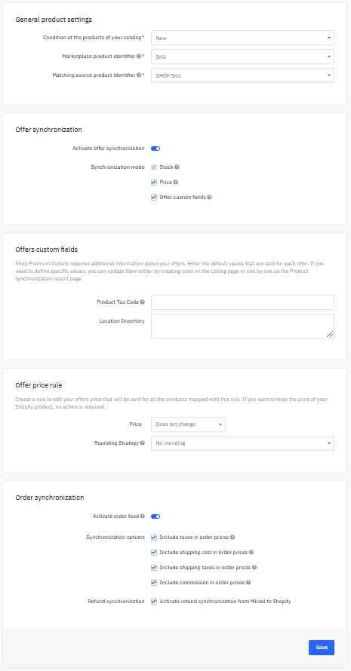
Mirakl Connect
ShopSimon™ Configuration In order to sync your inventory and order data with ShopSimon™, you will need to follow these steps : General Product Settings Condition = New Marketplace product identifier = SKU Product Identifier = SHOP_SKU Offer Synchronization Activate offer synchronization Synchronization Mode - Select ‘Price’ & ‘Stock’ Offer Price Rule Use this field to create a discount on all ShopSimon™ products - always on sale price and/or extra % off promotions. Order Synchronization Activate order synchronization Synchronization options - Default is to select all options Activate refund synchronization Click Save To Complete Configuration Setup.
Activate offer synchronization
Use this field to create a discount % on your assortment.
Activate order synchronization
Click here for additional information

Slide 9
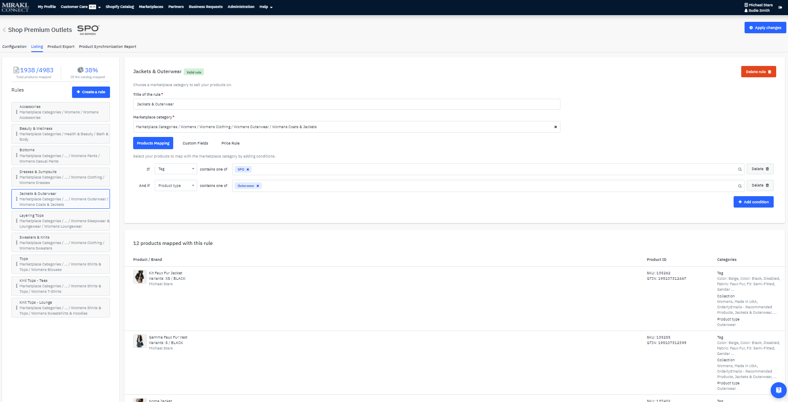
Mirakl Connect
Create Listings Build your ShopSimon™ assortment for specific categories through the filtering of your Shopify product catalog using Tags, Collections, Product Type, and keywords in Titles. You will create a “Rule” for each applicable category.
Make sure to ‘Apply Changes’ after creating new “Rules.’
Total skus mapped
ShopSimon™ category ‘Rule’ maps to
Set of ‘Rules’ comprising your ShopSimon™ assortment. In order for a sku to export to ShopSimon™, it must be included in a ‘Rule.’
Create ‘conditions’ to filter your skus to a ShopSimon™ assignable category.
Total skus included in ‘Rule’
Click here for additional information

Slide 10
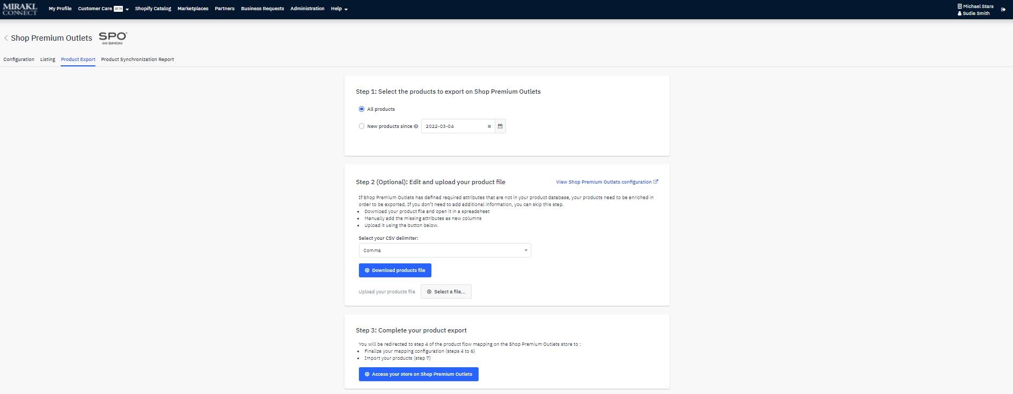
Mirakl Connect
Export Data After building your ShopSimon™ assortment using the product listing ‘Rules’, the next step is to create an export file that will be used for mapping your catalog into the ShopSimon™ portal. The mapping exercise will take place in ShopSimon™ portal using the mapping wizard. Step 1: Select the products to export During onboarding you will select ‘All products.’ Once live it is recommend you use the date filter when adding new products. Step 2: Download products file A file will download from Mirakl Connect allowing you to review before mapping/importing into ShopSimon™ portal. It is recommended you double check the file to make sure all required product attributes are included in file. Step 3: Complete your export Select “Access your store on ShopSimon™” to begin the mapping exercise. You can also import the export file directly into the mapping wizard in the ShopSimon™ portal.
Use the date filter to narrow-down the product data included in the export file. During onboarding you will select ‘All products.’
Click here to import your data into the ShopSimon™ mapping wizard
Click here for additional information

Slide 11
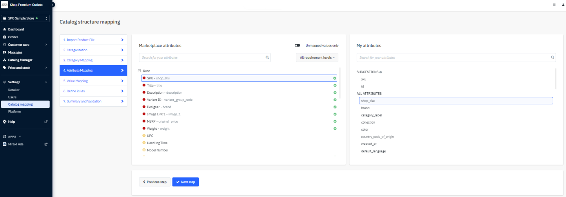
Data Integration
Click and drag Categories, Attributes, and Values from Seller to ShopSimon™
ShopSimon™ Mapping Wizard ShopSimon™ Portal: Settings > Catalog Mapping The final step to integrate your product catalog into the portal is to define a correlation table between your product information and the required attributes on ShopSimon™. You will need to follow these same steps any time you add new products to the portal. Steps To Map Your Product Catalog: Export file from Mirakl Connect Import Product File Categorization Category Mapping Attribute Mapping Value Mapping Define Rules Summary and Validation If you select “Access your store on ShopSimon™” from Mirakl Connect you will automatically skip to step 5 - Attribute Mapping. The category mapping was completed when ‘Rules’ were set up during configuration.
ShopSimon™ Attributes
Seller Attributes
Click ‘Next Step’ to save all updates and move forward.
Prerequisite To Mapping
Prior to starting the mapping process,
make sure all mandatory attributes for
each category you wish to add are
present in your product file.
Click here for additional information

Slide 12
Data Integration
Orders, Fulfillment, & Refunds The Shopify connector allows retailers to review and manage orders they are receiving through the ShopSimon™ vendor portal. Key functionalities include: View all ShopSimon™ orders and details in real-time Synchronize order status and send basic shipping tracking information into ShopSimon™ portal. Using the Shopify connector, a usual order workflow will look like this: Customer places order on ShopSimon™, the order is created in your ShopSimon™ vendor portal. In Shopify, the retailer goes to Orders > All Orders - orders will include the ShopSimon™ order number as well as identify the source as “ShopSimon™.” The retailer reviews and manages the order by clicking on the Order. Once a product is shipped, the seller creates a shipment in Shopify for this order which will update the status in ShopSimon™ Portal to “Shipped.” Refunds ShopSimon™ will initiate all returns and provide the customer with a prepaid return label to retailer’s distribution center. Once return is accepted by retailer, the retailer will need to complete the refund in the ShopSimon™ portal.

Slide 13
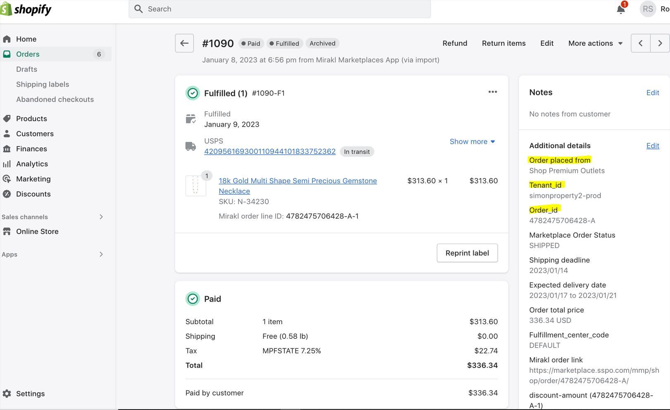
Data Integration
ShopSimon™ Order in Shopify

Slide 14
Roadmap To Live
MIRAKL CONNECT/SHOPIFY TARGET GO LIVE DATE: DISCOVERY Execute contract Determine onboarding kick-off call date WEEK 1: ShopSimon™ Portal account setup completed W9 & bank verification letter submitted WEEK 2: Mirakl Connect account setup completed Tag ShopSimon™ assortment in Shopify with ‘SIMON’ tag Sync Mirakl Connect to your Shopify store Send ShopSimon™ required creative assets and brand bio Brand Manager introduction WEEK 3: Create ShopSimon™ product listings in Mirakl Connect Initial data mapping completed in ShopSimon™ Portal Ingestion errors resolved from initial imports Activate offer synchronization Activate order synchronization ShopSimon™ team completes brand storefront build WEEK 4: ShopSimon™/Retailer approval to go live
SAMPLE MEETING SCHEDULE:
Week 1 - Onboarding Kick-Off Call
Onboarding Timeline
Requirements
Next Steps
Weeks 2 - 4: Status Updates x Q&A
Connector configuration
As needed
Week 3: Brand Manager Intro
Brand manager Intro
Promotions management
Week 4: Go Live Discussion
Prepare to launch

Slide 15
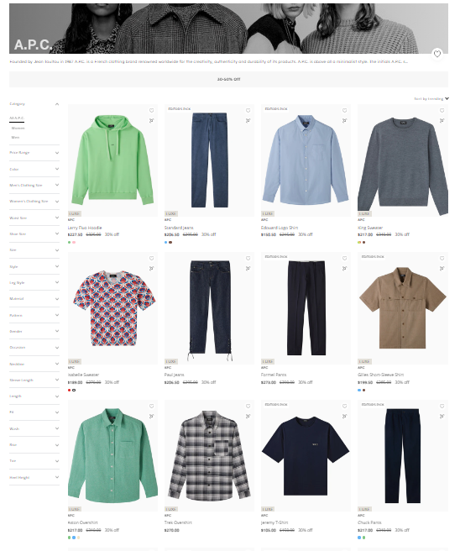
Store Launch
Live! Now What? Congratulations! You have successfully completed onboarding and indicated your approval and readiness to go live on ShopSimon™. Next steps are: ShopSimon™ will accept and activate your brand into our front end according to the mutually agreed upon go live date. You will be introduced to your dedicated Brand Manager and establish optimal method for your business to communicate about ShopSimon™ performance, marketing opportunities, and operational details. You will need to continue to monitor the ShopSimon™ site to ensure your product catalog is displaying as you intended. ShopSimon™ will issue a month-end financial statement followed by a direct payment within 30 days following the end of each month.

Slide 16
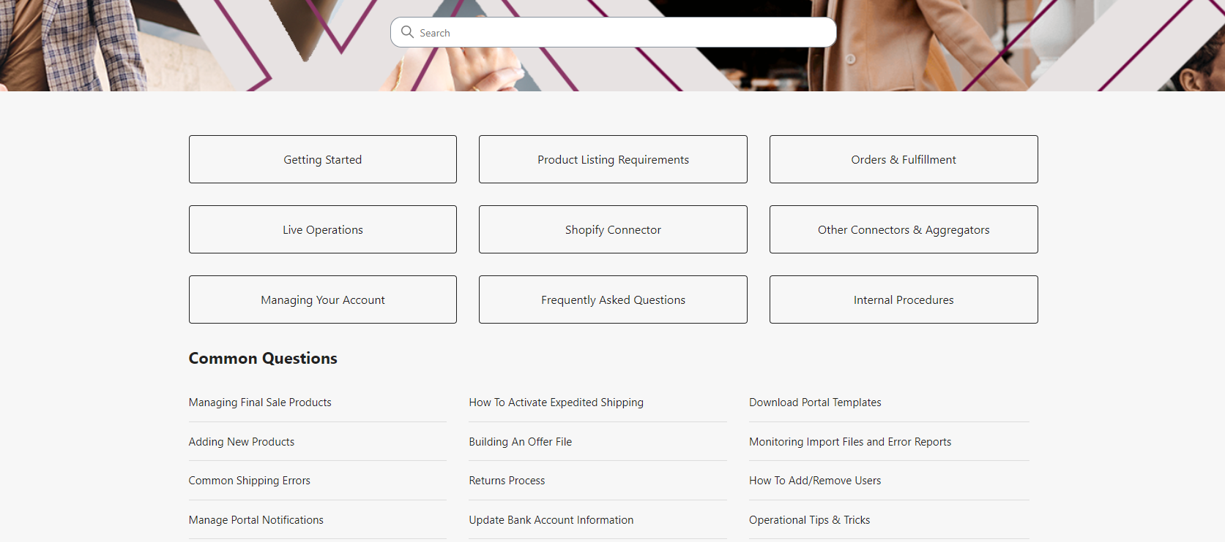
Retailer Hub
Click here to access the ShopSimon™ Retailer Hub. This self-service knowledge base provides merchants instant access to information about the marketplace and best practices for common tasks you will encounter managing your ShopSimon™ store.

Slide 17
Thank you for your partnership!
Please contact the ShopSimon™ Operations team for additional support.
sellersupport@shopsimon.com
11

